Slide 1
Day 2: RNA-seq
Alejandro Mejia Garcia, PhD Student, Human Genetics,
McGill University

Slide 2
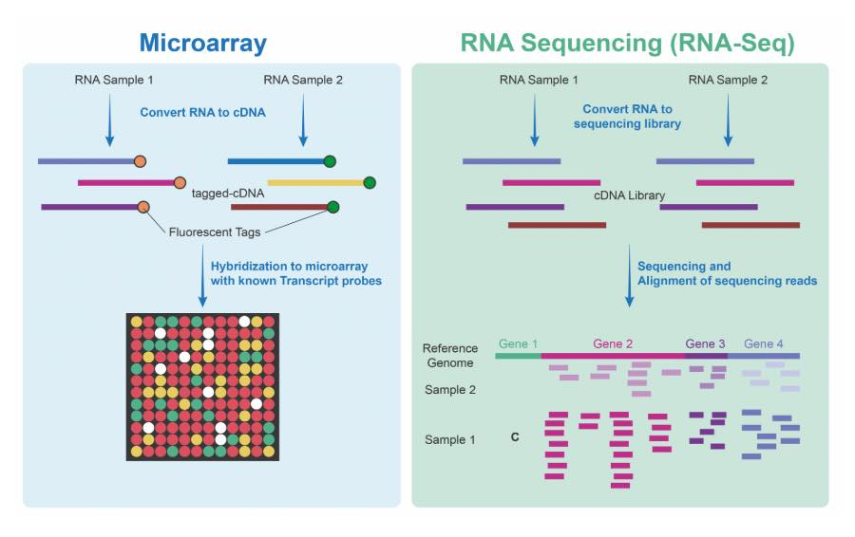
Microarrays vs RNA-seq

Slide 3
What type of RNA we want to capture?
mRNA: kit that uses poly T tails to capture poly A mRNA
Total RNA: captures everything (except ribosomal RNA)

Slide 4
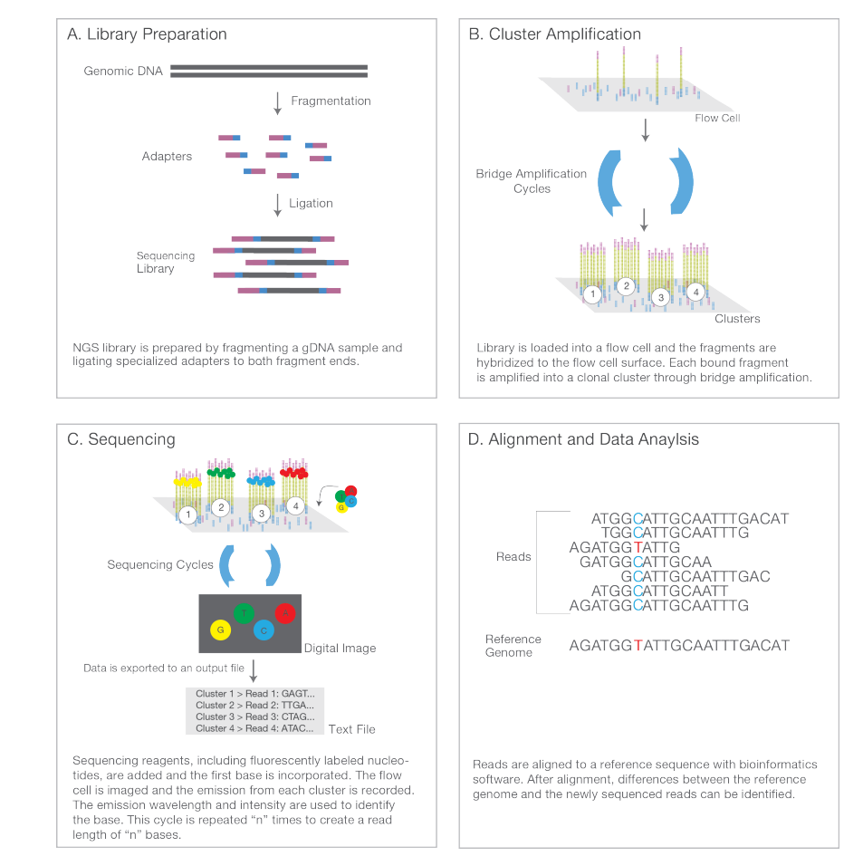
Next generation sequencing (NGS)

Slide 5
Next generation sequencing (NGS)

Slide 6
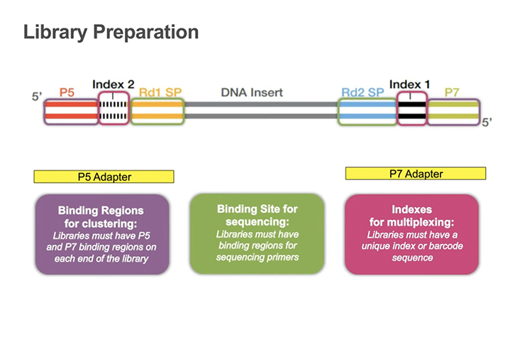
Adapters and indexes for multiple sample

Slide 7
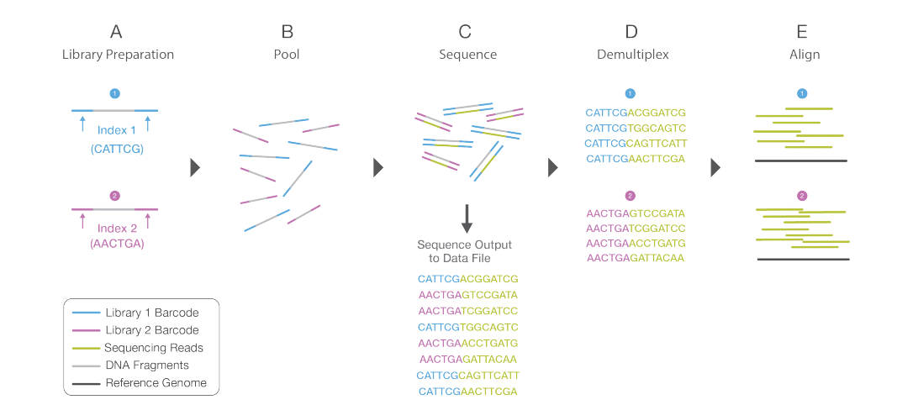
Why we need indexes?
Multiple simples in the same flow cell

Slide 8
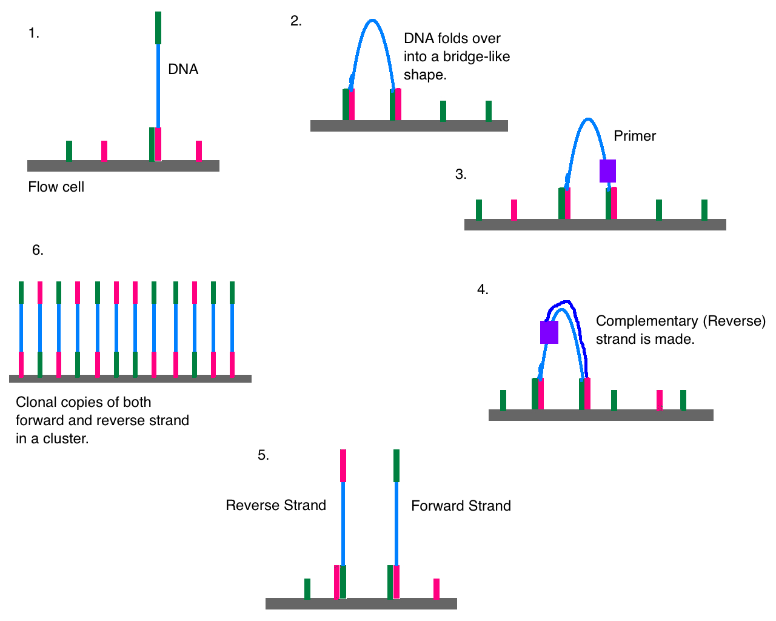
Bridge amplification

Slide 9
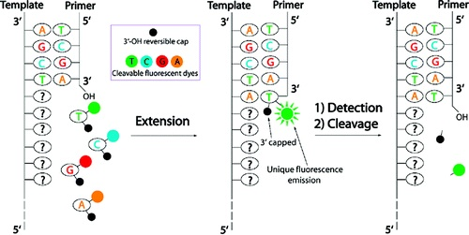
Sequencing by synthesis

Slide 10
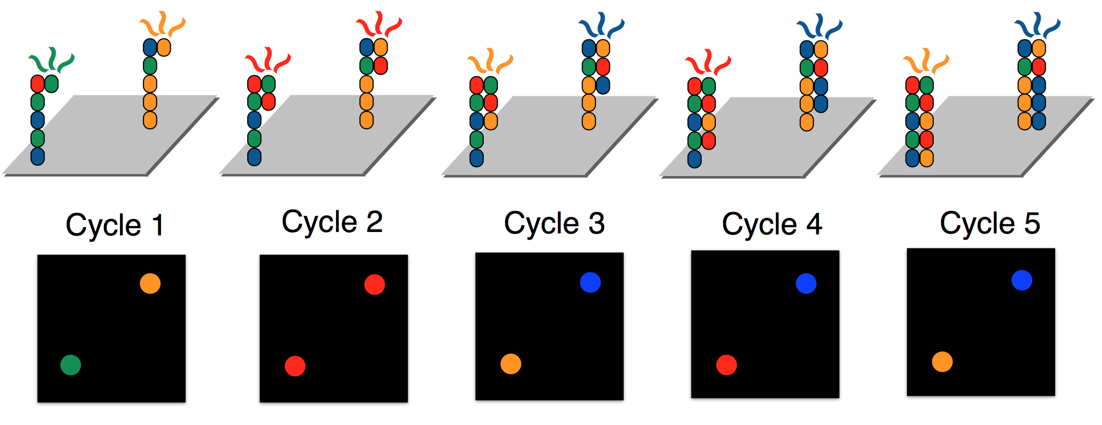
Nucleotide sequences and quality scores

Slide 11
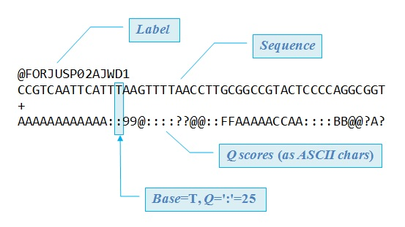
Raw sequencing files
FASTQ format: Q scores: phred scores

Slide 12
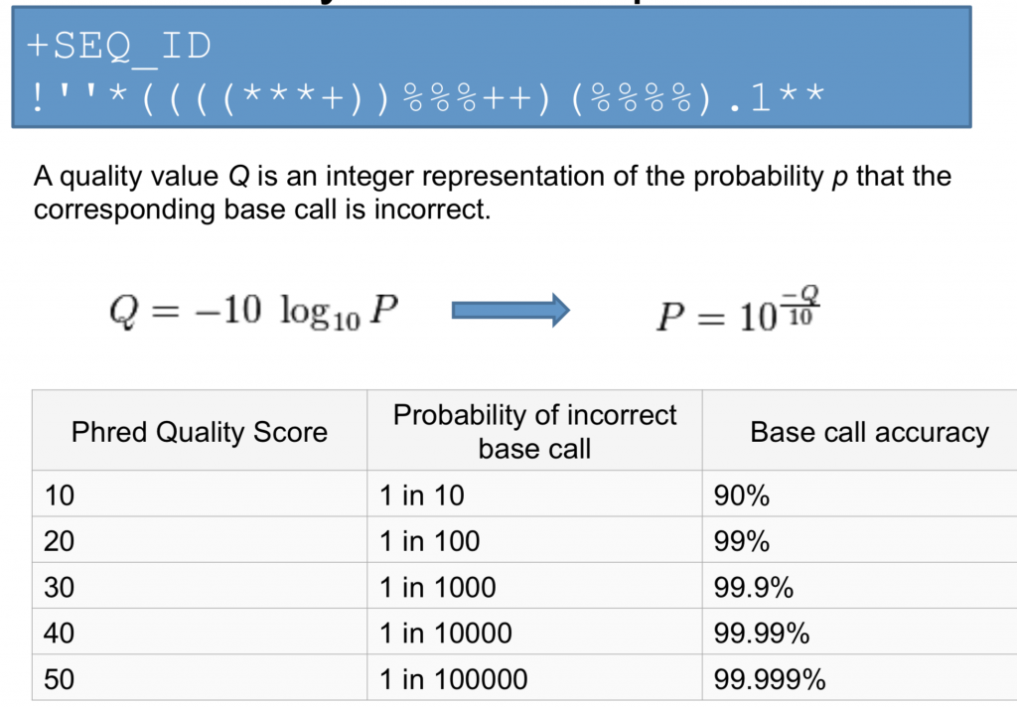
Phred scores

Slide 13
Quality control with FASTQC
We want to make sure the bases in our reads have Good quality scores, metrics:
Per base quality (position in the read)
Per base GC content
Per base N content
Sequences length distribution
Sequence duplication levels
Overrrepresented sequences

Slide 14
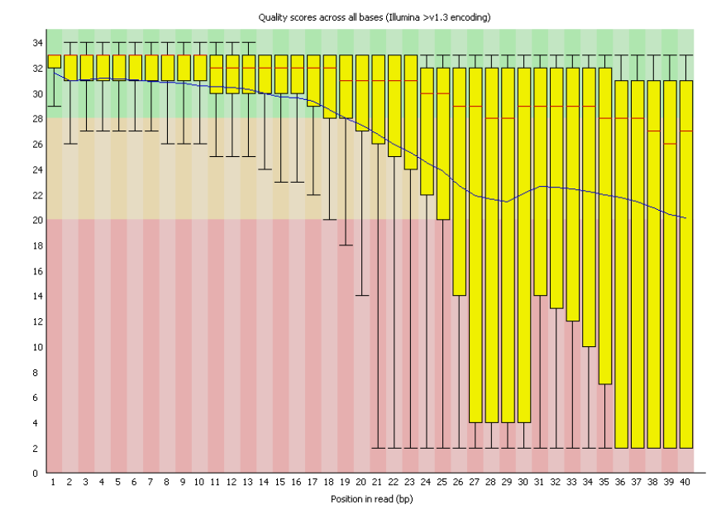
Per base quality
Phred scores

Slide 15
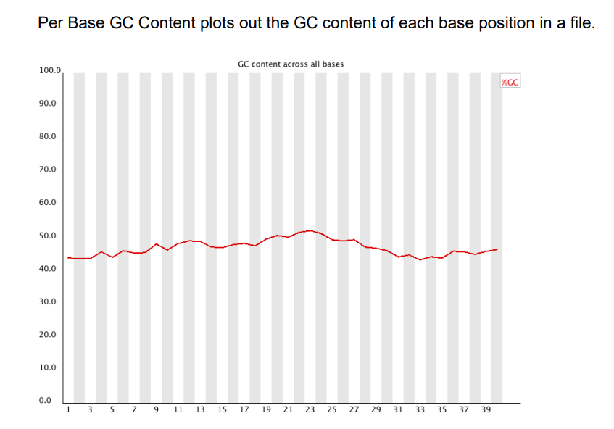
GC content

Slide 16
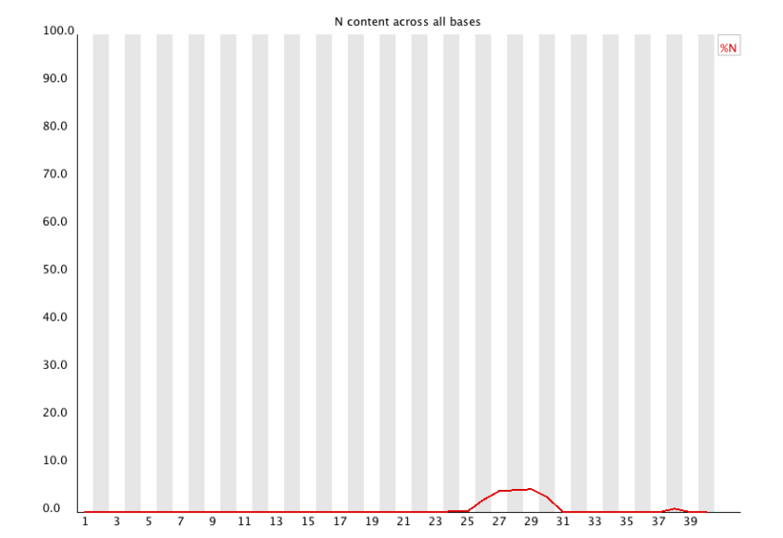
Per base N content

Slide 17
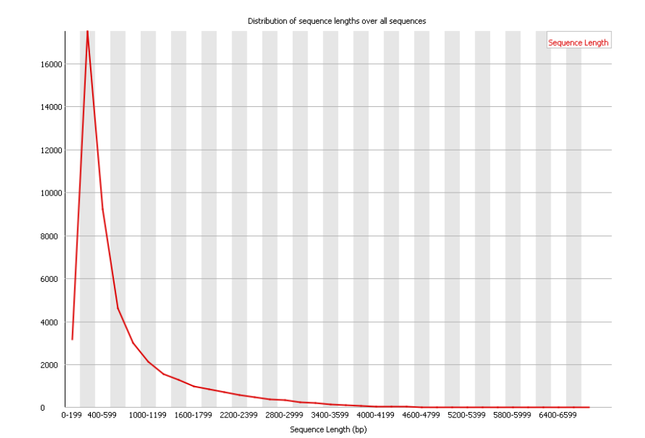
Sequence length distribution

Slide 18
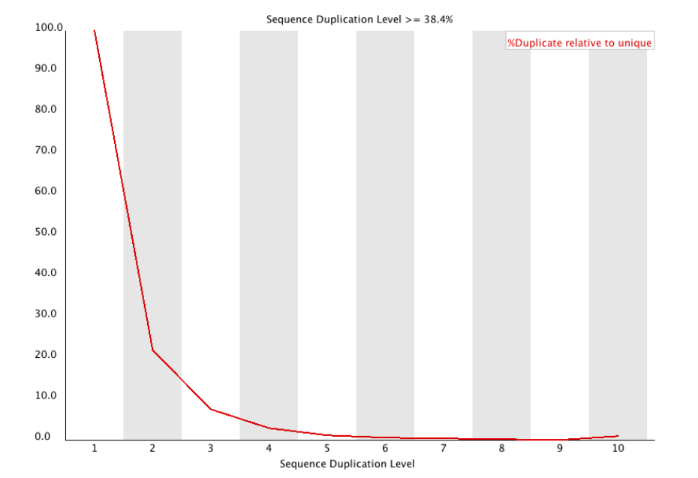
Duplicate sequences

Slide 19
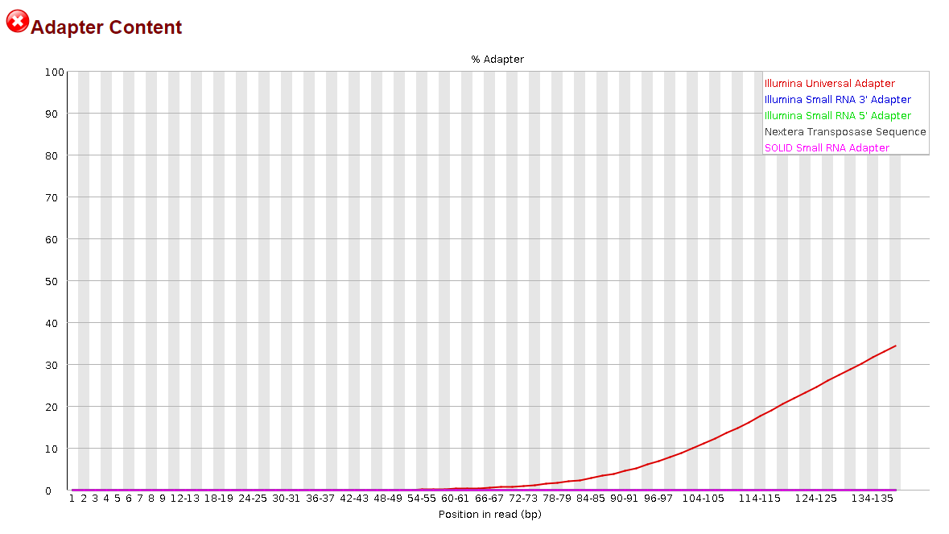
Adapter content

Slide 20
Read trimming
We want to remove:
Adapters
Bad quality bases
Bad quality reads
If we don’t remove them, alignment will fail because adapters are not part of the human genome
After trimming, we run FASTQC again to check if it worked!

Slide 21
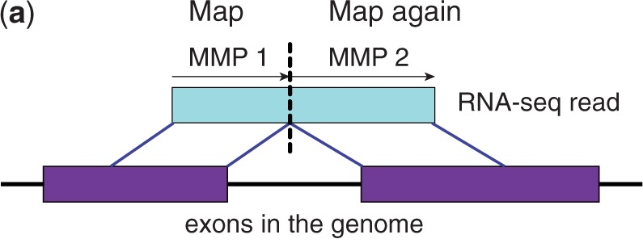
Alignment
We need an splice-aware aligner because we captures mRNA (splicing removed introns)

Slide 22
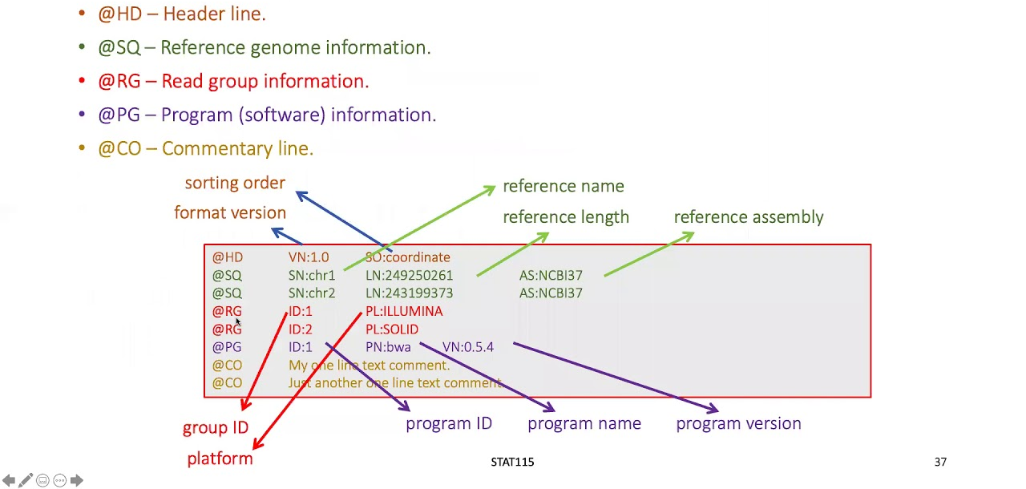
SAM/BAM format
Stores reads aligned to a reference genome

Slide 23
Post-alignment QC
We need to remove reads with low quality scores

Slide 24
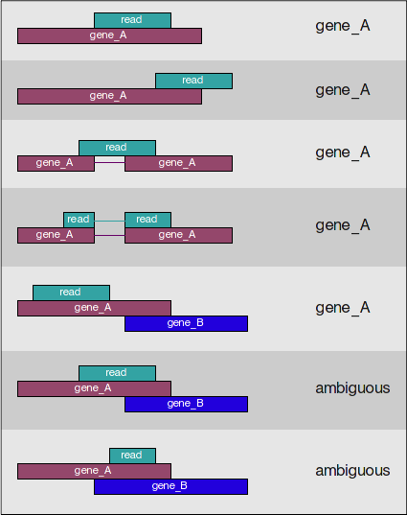
Generating count matrix
Featurecounts only uses uniquely mapped reads
https://hbctraining.github.io/Intro-to-rnaseq-hpc-orchestra/lessons/07_rnaseq_workflow.html

Slide 25
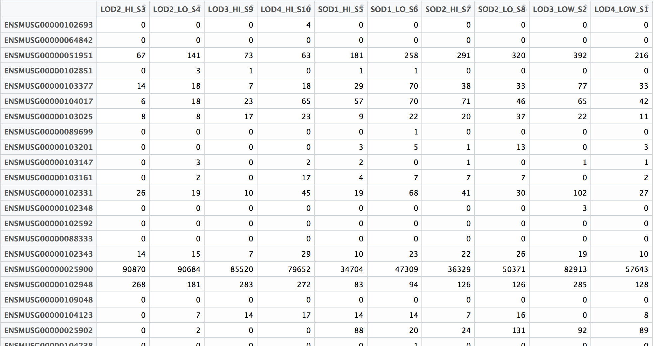
Count Matrix

Slide 26
Using Genpipes
https://genpipes.readthedocs.io/en/genpipes-v-3.6.2/user_guide/pipelines/gp_dnaseq.html
Automated pipelines available, already installed in ComputeCanada
They provide a very robust way of running long batches

Slide 27
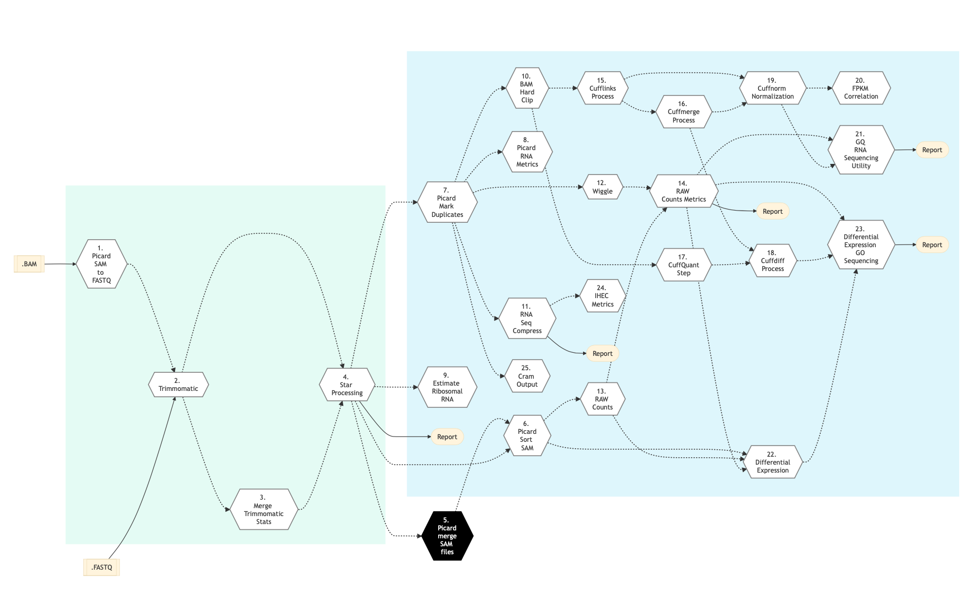

Slide 28
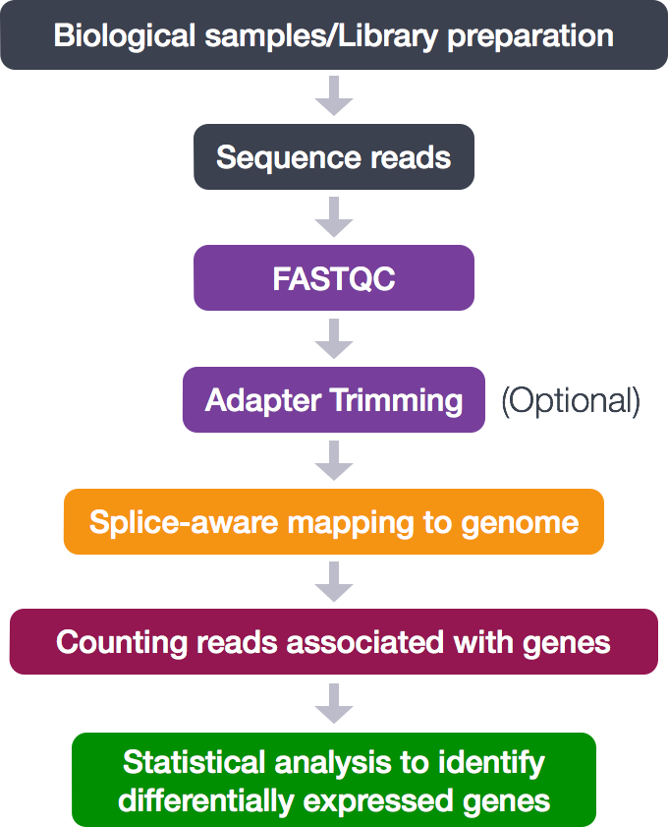
Summary of the RNA-seq pipeline

Slide 29
Bonus
We can use RNA-seq data for variant calling.
As long as the gene is expressed, the reads contain data necessary to call variants
The pipeline is very similar to whole-exome sequencing

Slide 30
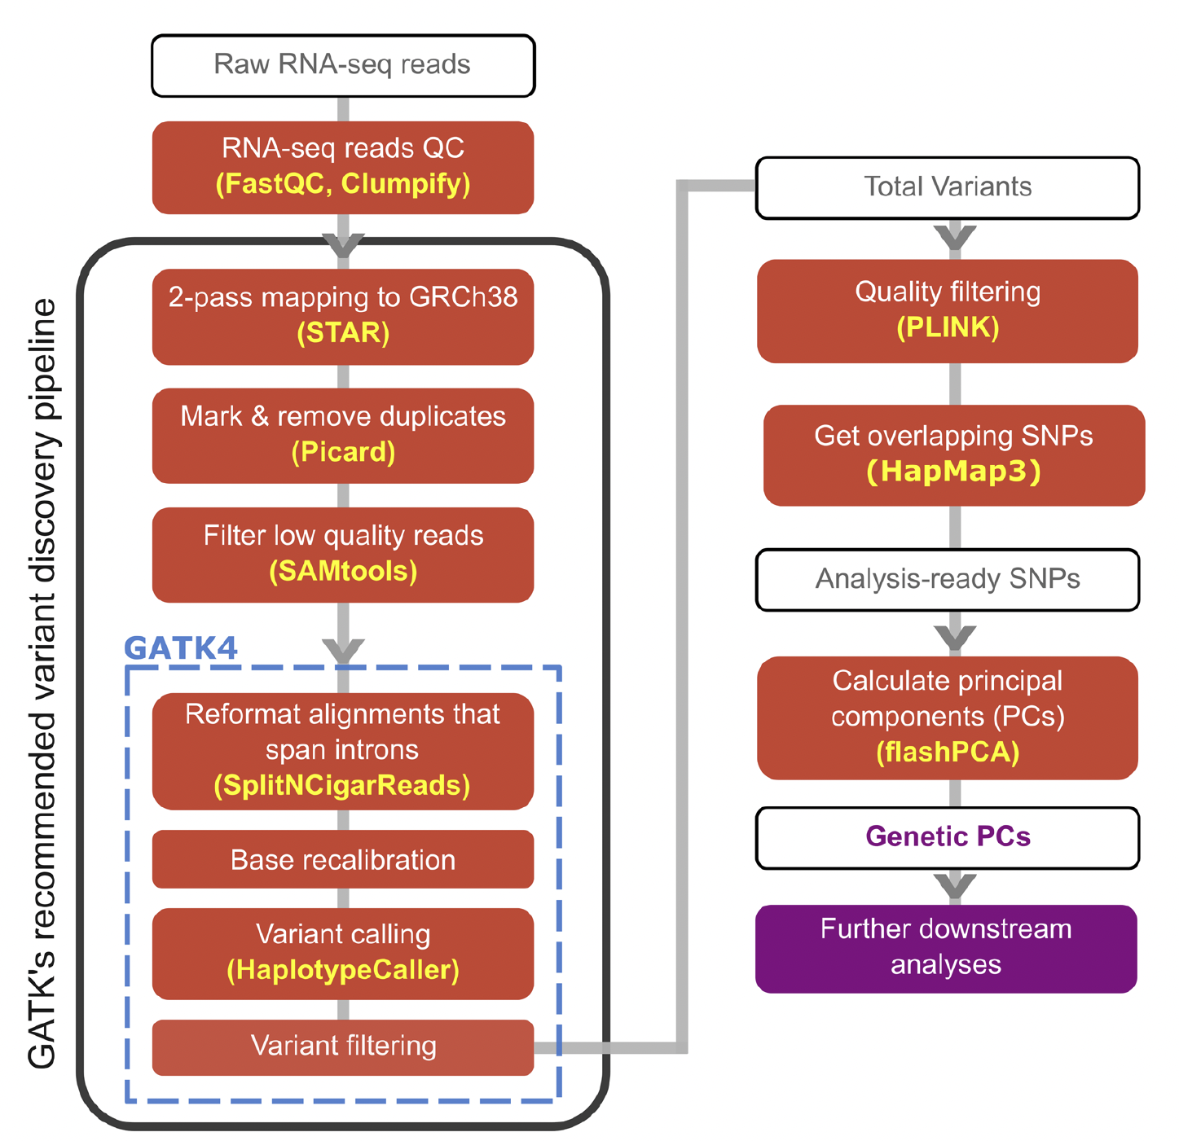
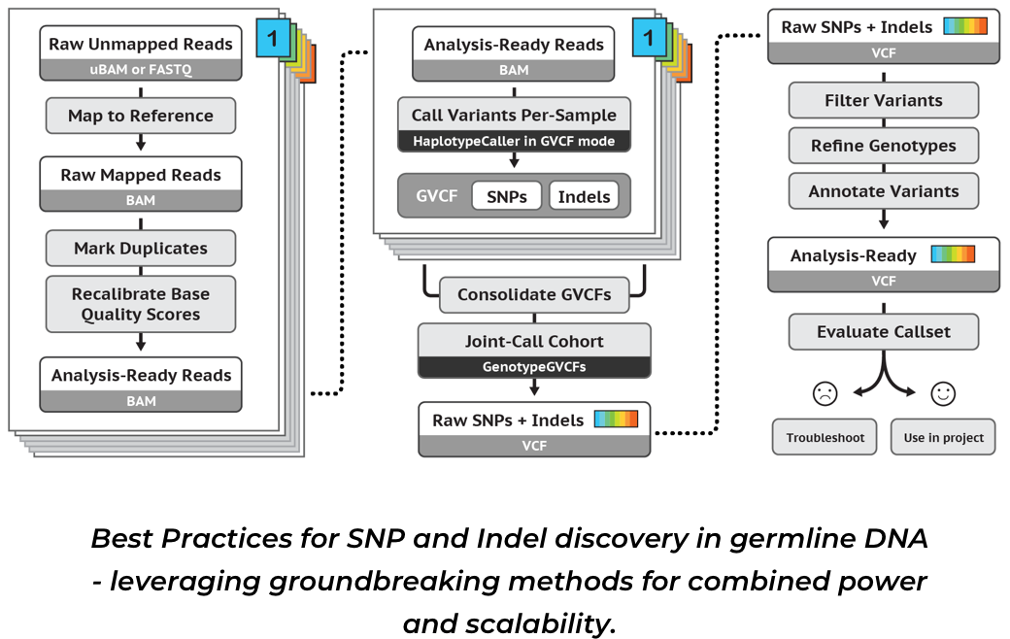
DNA vs RNA for variant calling
RNA
DNA
Fachrul, M., Karkey, A., Shakya, M. et al, Commun Biol 6, 804 (2023)
https://gatk.broadinstitute.org/hc/en-us/sections/360007226651-Best-Practices-Workflows

